Slide 1
Public Health Foundation: Proposal for a Satellite Clinic
Name
Institution

Slide 2

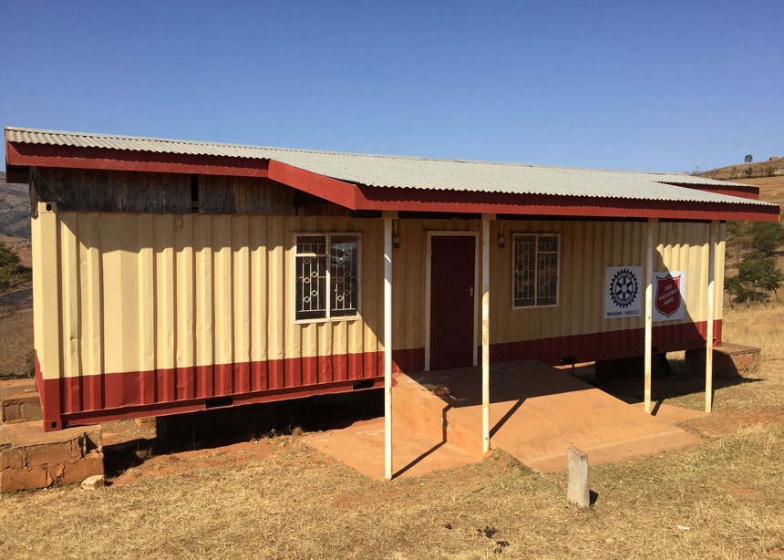
Presentation Overview
Introduction
Assessment
Recommendations and implementation
Conclusion
Notes:
This paper presents a proposal to the Board of Directors, Public Health Foundation, to determine the practicality of setting up a satellite clinic in a remote area with high number of incident reporting.

Slide 3

Introduction
This report guides the Public Health Foundation on the determining the practical application of a satellite clinic.
The Public Health Foundation aims at improving public heath to ensure healthier communities.
Satellite clinic improves incident reporting in the remote areas.
Notes:
As part of the organization’s strategy to improve population health, establishing a satellite clinic would play a big role in improving the incident reporting processes in the remote areas. This project is also in line with the mission of the organization. This also improves the safety of the patients (Macrae, 2016). Failure to report these incidences denies the chance of the care providers to learn from these incidents (Mitchell et al., 2016)

Slide 4

Internal and external stakeholders
Internal stakeholders will include members of the Board of Directors, the staff members, donors, volunteers, trustees, research scientists and trustees.
Members of the public, clients, patients, leaders of public, private and non-profit organizations served by Public Health Foundation.
Notes:
This project will take a consideration of the people that will be affected in the process of executing the project and even after the project is put in place. According Cuppen (2016), it is important for public health decision makers to ever consider those affected by their actions and decisions. The decision makers must therefore identify the stakeholders and evaluate their importance and their influence in a project (Andriof et al., 2017)The project will therefore assess the internal and external stakeholders and the positive and negative effects of this project on them.

Slide 5

Internal and external environment challenges
External environments include the organizational structure, communication, access of medical equipment and learning
External environments include consumers, technology, public participation as well as government policies.
Notes:
To complete this project, the Public Health Foundation will also consider the internal and external factors that will affect the completion of the project. The organization will need to adopt a structure that will enable flexibility and speed, and allow proper communication. A Matrix organizational structure can be applicable in this kind of project (Burton et al., 2015). The organization will also need to evaluate the available medical equipment as well as the equipment that we need to purchase or outsource.
The action team members also need to learn the how to make the project process and the project itself work. This includes technology needed to make the satellite clinic work effectively. The organization will also need to evaluate the level of public participation needed in this project. Public involvement in the project is a crucial part of the project. It will enable the members of the public to give their feelings, preferences as well as showing the level of acceptance of the project (Degeling, carter and Rychetnik, 2015)
The government policies that may affect the implementation of the project need to be put in consideration. This will prevent the organization from getting in the wrong side of the law.

Slide 6
SWOT Analysis
Strengths: A very strong team of Board of Directors, innovative programs, strong staff and staff values..
Weaknesses: The project needs a large amount of funding, additional training is needed for the staff members, negative image of public health in public
Opportunities: Most of people do not travel to hospitals for incident reporting, no dominant competition, advanced technology.
Threats: Economic shifts, seasonality, inadequate public awareness.
Notes:
A SWOT analysis will be performed to identify the external and internal features of the organization that are going to influence setting up a satellite clinic. The SWOT analysis will help to improve the performances by maintaining the strengths and taking advantage of the opportunities. According to Phadermrod et al., (2019), this analysis will also help to reduce risks by coming up with strategies to deal with the threats and correct the weaknesses.

Slide 7
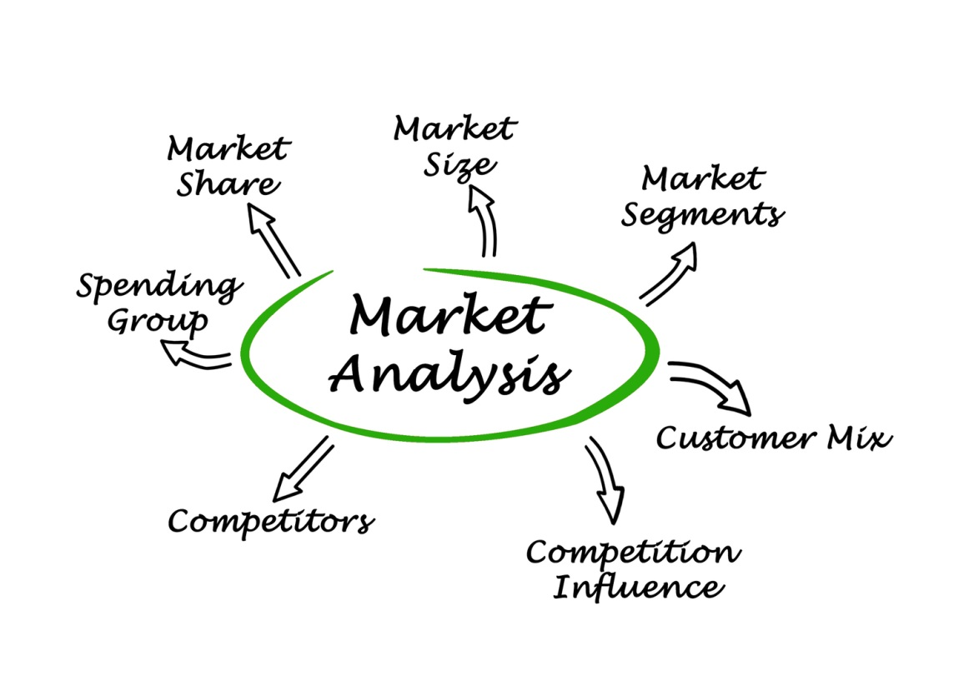
Market analysis
Market gaps
Market barriers
Demographics
Attitudes towards the project by public
Notes:
A market research and analysis is a crucial part of this project. The market research need to come up with market niches that need to be filled. This will be an opportunity for this project. The research shall also evaluate the possible barriers in the market in relation to this project. We shall also evaluate the demographic structure of the target community. This will enable us to determine the appropriate facilities to invest in, for instance, facilities needed by children and the elderly. The research will also evaluate how the public feel about the project. After the research, a market analysis shall be prepared to help in important decisions making.

Slide 8


Attracting quality Healthcare Personnel
Recruit and hire new talents
Create an attractive culture
Keep the employees happy
Offer welfare programs
Easy application process
Notes:
Being a new project, the organization needs to hire new personnel to work in the satellite clinic. Tactics to attract and hire such talents needs to be employed. These includes identification and hiring the right people. Having a working culture that allows the workers to enjoy their work is also very important. According to Thibault, Schweyer and Whillans (2017),
welfare programmes such as stress management are also crucial in attracting quality personnel. The organization should also adopt an application process that is short and easy for the candidates (Gourova & Gourova 2017)

Slide 9
Recommendations and implementation
Adopting a matrix organizational structure
Delegating duties
Getting feedback from the public
Dealing with the SWOT analysis report
Notes:
A matrix organizational structure does not use the hierarchical order of reporting relationships in an organization’s project but rather uses a grid structure. This structure ensures proper utilization of resources, faster process, smooth communication, and speedy decision making among others project (Burton et al., 2015). After adopting the structure, individuals are assigned roles according to their capabilities and abilities.
The organization shall prepare questionnaires to be filled by the members of the public I the area where the clinic will be set up. The views and expectations of the public will be used in decision making. The opportunities such as technology should be adopted to enable the satellite clinic address the current issues as well as emerging ones.
According to the SWOT analysis, the organization will need to source funds to purchase required equipment and resources. There is need to come up with scientific innovations to deal with the current perverse forces in the market. Lastly, a campaign is needed to ensure that members of the society are aware of the satellite clinic and its functions. This can be done in many ways including social media and mainstream media.

Slide 10

Value Adding Resources and Support.
Technology
New quality personnel
organization’s culture
Notes:
To have a successiful project, the organization needs to put in place strategies for adding value to the products and services. With the new technologies, there is need to plan for equipment replacement program to replace the old facilities with technology. There is also a need to evaluate the actual specifications needed for the new facilities, equipment as well as processes.
The organization will need to assess the market for the job and availability of potential workers. Recruiting new critical skills and offering to workers whose skills become obsolete.
Organizational culture plays a good role in shaping the organization and its activities. The culture guides how individuals behave since they share common values, assumptions and norms (Ginter,Duncan & Swayne,2018). The leaders must therefore effectively communicate the organization’s and project’s vision, mission and goals in writing and orally.

Slide 11
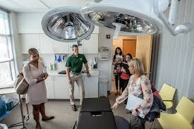
Strategic Initiatives
Improving the clients experience
Evaluation of quality performance
Evaluate the capital needed currently and in future
Evaluate long-term sustainability
Notes:
To overcome the impending challenges in implementation of this project, the organization needs to come up with initiatives that will ensure smooth delivery of products as well as services. The organization can, for instance, adopt client centered strategies to improve client experience. This will be supported by the continuous research embraced by the organization.
The public health industry is being made more transparent by the information technologies. As a result measuring quality performances is important to enable ranking. This helps in shaping peoples’ perspective towards the organization.
The organization executives will need to discuss the need for funds and loans for current situation as well as the future (Bryson, 2018). They also need to assess whether the current financial situation can support borrowing.
The executives also need to discuss candidly their long-term sustainability. This including assessing the facilities and financial situation.

Slide 12

Long-term and Short-term Plans for implementing Strategic initiatives
Preparing budgets and financial statements
Sourcing funding
Increasing facilities to improve clients’ experience
Notes:
The organization will need to discuss and prepare a budget indicating the amount of capital needed to complete this project. Once a budget has been prepared, the available capital will be evaluated to determine how much more is still needed.
As part of improving the clients experience, the organization will invest in the appropriate resources, equipment and technology to improve the services. This may include creating platforms for easy communication and purchasing ambulances for fast responsiveness to incident reports.

Slide 13
Benchmarking the project
Setting goals
Learning from others.
Notes:
To bench mark this project, this organization will need to not only set specific goals but also using external standard by other organizations as a learning strategy. According to Iyer and Banerjee (2016), benchmarking will provide external standards that will help this organization to set realistic goals. Though challenging, the goals will be acceptable to those in charge. Benchmarking will also help to point out the best organizations to learn from. The organization shall therefore receive data from benchmarking and analyse it. We shall also participate in both internal and external benchmarking.

Slide 14
Conclusion
The problems associated with incident reporting need critical intervention by the hospitals and the entire healthcare sector.
As a result, the stakeholders need to know what is happening in order to take the appropriate actions.
Setting up a satellite clinic will be one of the steps towards improved incident reporting. This will enable physicians to work remotely with the organization.
A satellite clinic will also enable us to provide more services to the community.
With the current position of this organization, we need to put a keen interest on the stakeholders, the internal and external factors , the market as well as our staff.
We also need to pay attention on the proposed recommendations in order to implement the project.
Notes:
The Alcohol laws of Australia are used to regulate the sale and consumption of alcoholic beverages within the nation's boundaries. In Australia (as is the case with many other countries and territories), it is illegal for a person that is under the age of 18 to either buy, possess or drink alcohol (Australian Capital Territory 2010). As such, though all of Australian states have their own specific laws as relates to the consumption of alcohol, the legal drinking age of all its states is 18; this includes the states of Queensland, Tasmania, Northern Territory, New South Wales, South Australia, Western Australia, the Northern Territory and the Australian Capital Territory. Alcohol laws in Australia, therefore, place specific restrictions on the marketing of alcoholic products to specific segments; as such, alcoholic products such as beer can only be marketed and sold to specific consumer segments, with a particular focus on those markets that are considered legal (Australian Capital Territory 2010).

Slide 15
References
Mitchell, I., Schuster, A., Smith, K., Pronovost, P., & Wu, A. (2016). Patient safety incident reporting: a qualitative study of thoughts and perceptions of experts 15 years after ‘To Err is Human’. BMJ Qual Saf, 25(2), 92-99.
Macrae, C. (2016). The problem with incident reporting. BMJ Qual Saf, 25(2), 71-75.
Cuppen, E. (2016). 15 Stakeholder Analysis. Foresight in Organizations: Methods and Tools, 208.
Andriof, J., & Waddock, S. (2017). Unfolding stakeholder engagement. In Unfolding stakeholder thinking (pp. 19-42). Routledge.
Burton, R., Obel, B., & Haakonsson, D. (2015). How to get the matrix organization to work. Journal of Organization Design JOD, 4(3), 37-45.

Slide 16
References
Gourova, N., & Gourova, E. (2017, March). Attracting talents. In Proceedings of the VikingPLoP 2017 Conference on Pattern Languages of Program (p. 5). ACM.
Iyer, K. C., & Banerjee, P. S. (2016). Measuring and benchmarking managerial efficiency of project execution schedule performance. International Journal of Project Management, 34(2), 219-236.
Macrae, C. (2016). The problem with incident reporting. BMJ Qual Saf, 25(2), 71-75.
Mitchell, I., Schuster, A., Smith, K., Pronovost, P., & Wu, A. (2016). Patient safety incident reporting: a qualitative study of thoughts and perceptions of experts 15 years after ‘To Err is Human’. BMJ Qual Saf, 25(2), 92-99.
Phadermrod, B., Crowder, R. M., & Wills, G. B. (2019). Importance-performance analysis based SWOT analysis. International Journal of Information Management, 44, 194-203.
Thibault Landry, A., Schweyer, A., & Whillans, A. (2017). Winning the war for talent: Modern motivational methods for attracting and retaining employees. Compensation & Benefits Review, 49(4), 230-246.

